Slide 1
Adaptations of CS50x
in Indonesia
By:
Ni’mah Faadlilah, S.Pd.
Jakarta, March 2024

Slide 2
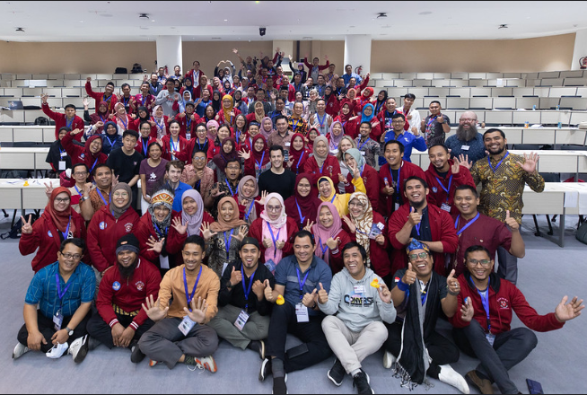

Slide 3
PROFIL
Name : Ni’mah Faadlilah, S.Pd.
Occupation : ICT Teacher
School : UPT SMP Negeri 3 Garum,
Kabupaten Blitar Jawa Timur
Hobby : Reading, writing
Achievement : Teaching Fellow of CS50x
Indonesia-Harvard University
2023-2024

Slide 4
Experience during CS50
Difficulties:
Time management
Forget about the material of Computer Science
Have no background in Computer Science
Strict discipline in submitting assignments (Quiz, Labs, Pset, test, Final Project)
The task are out of the box
Lack of Literacy
Language

Slide 5
Experience during CS50
Solution:
Make priority, commit, and focus
Adapt the way of learning with the new system
Read more, read announcement page in the website, another reference, rewatch video lecture
Stay calm, ask if don’t understand
Always attend section and Office Hour

Slide 6
Experience during CS50
Achievement:
Speaker in the teacher community
Using Flask to create e-LKPD easier
Building computational thinking
Realize that digital literacy is important
Process is the most importing than result

Slide 7
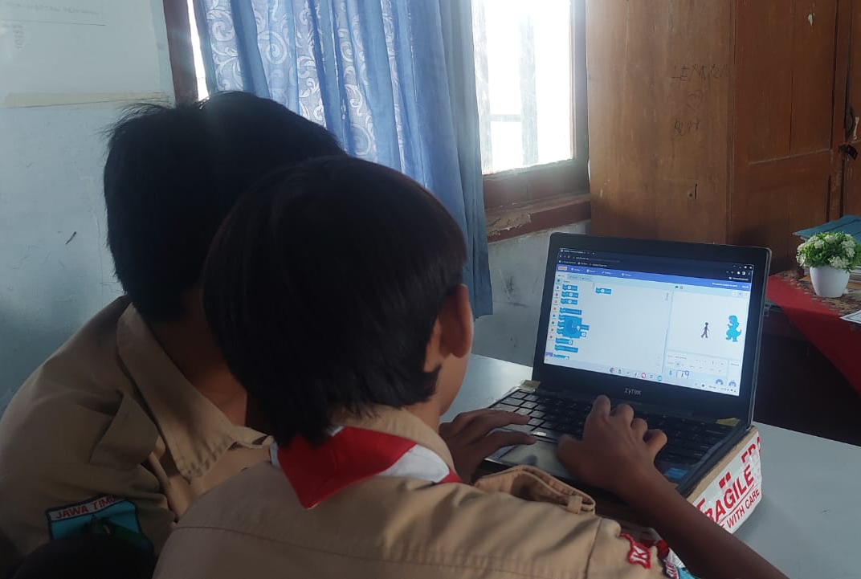
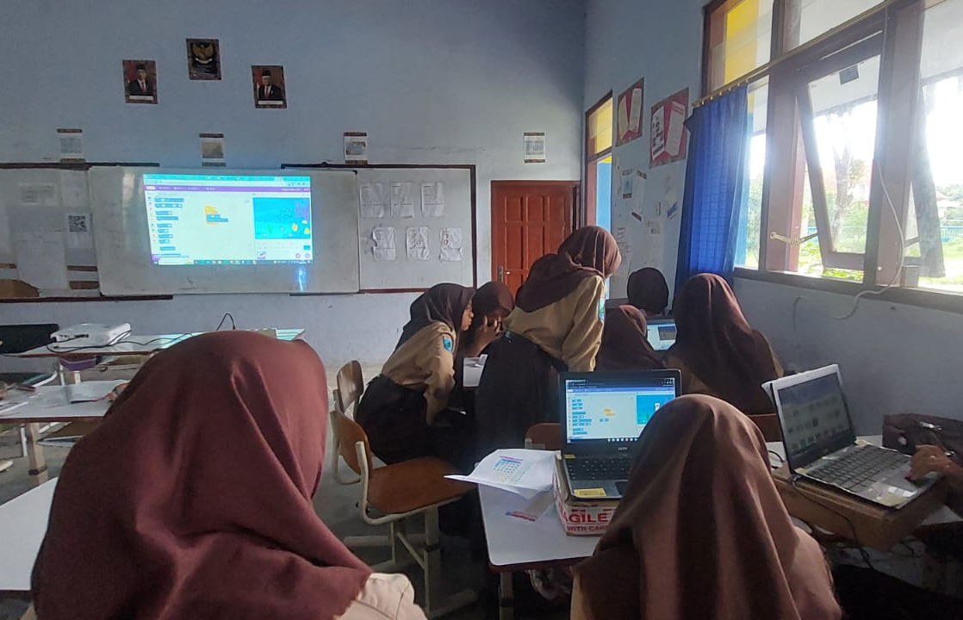
Implementation in School, Class, and Community
1. In Junior High School - Scratch

Slide 8
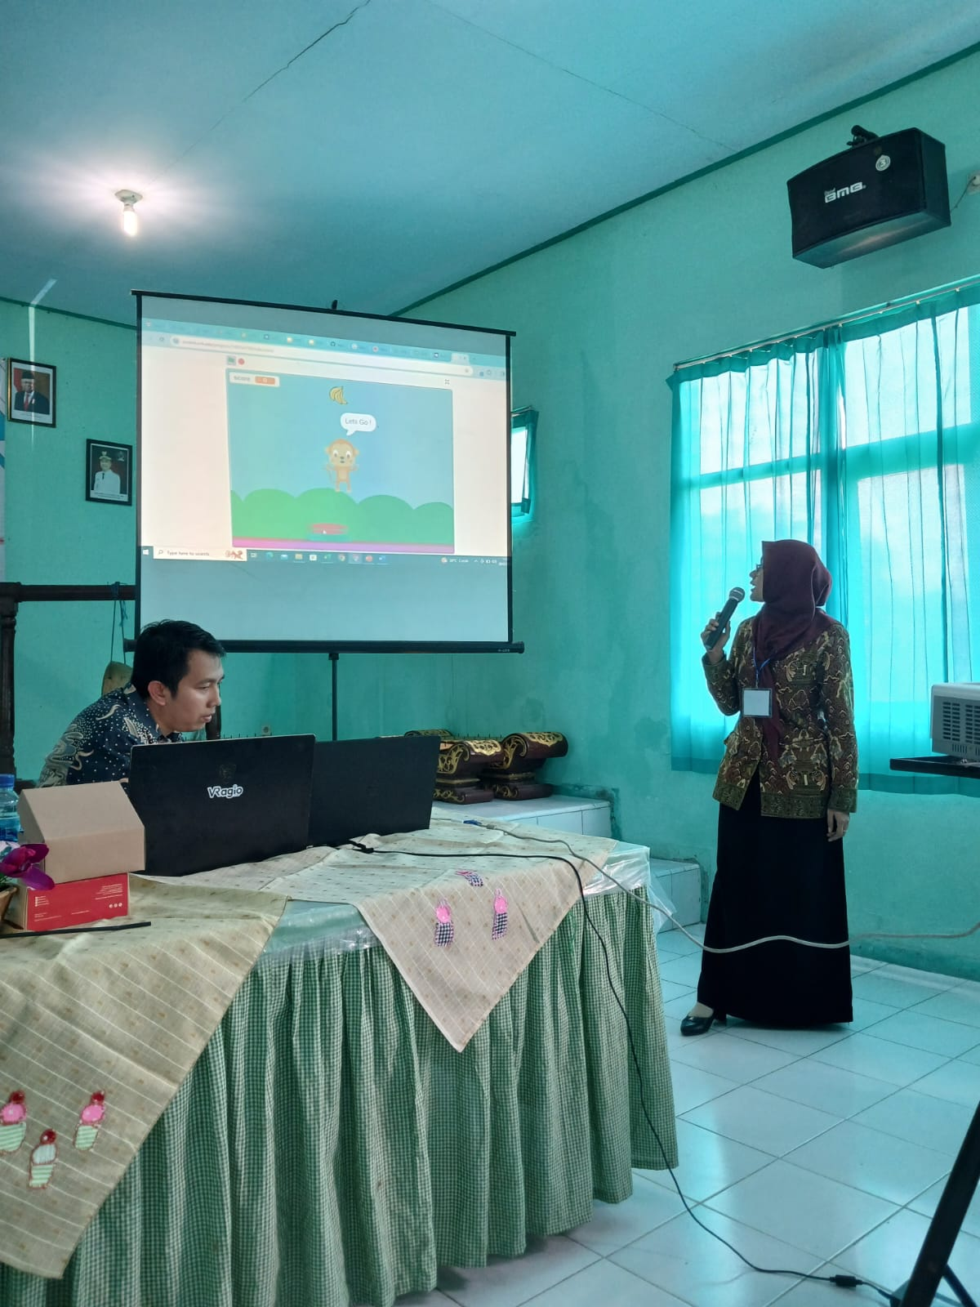
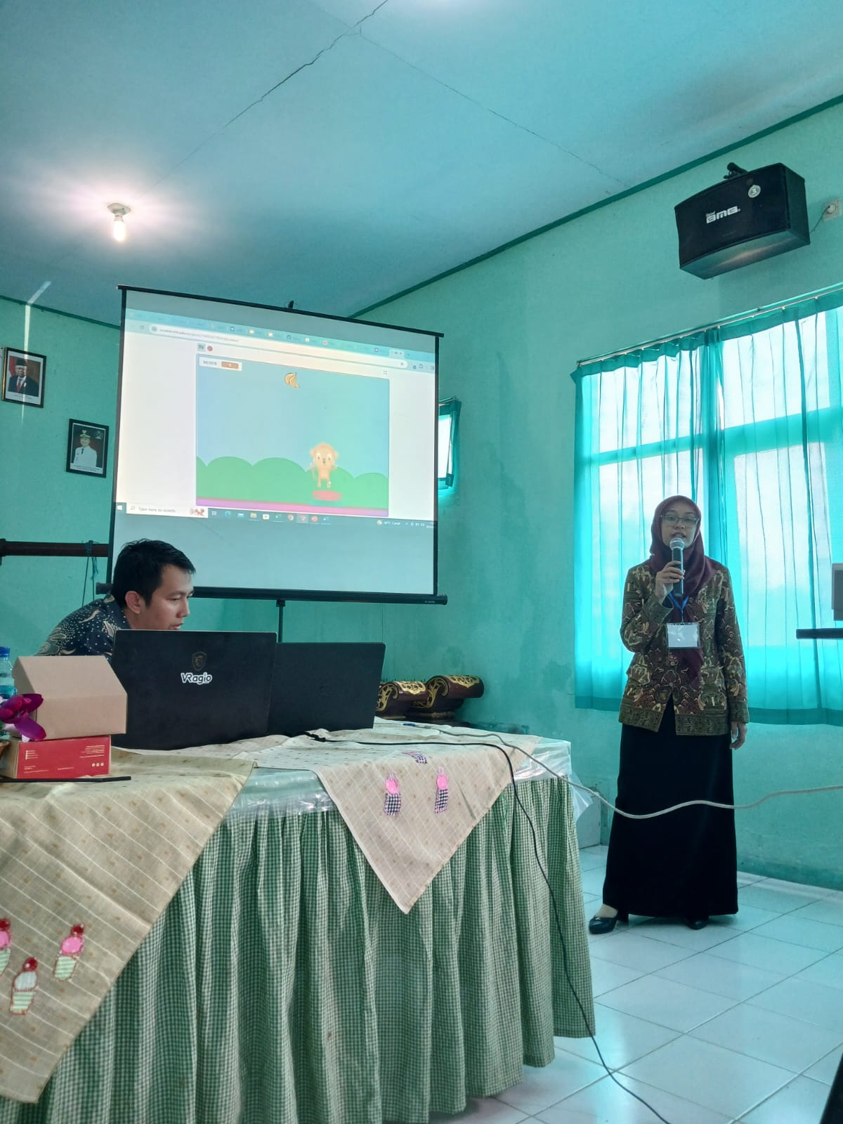
Implementation in School, Class, and Community
1. In Junior High School - Scratch

Slide 9
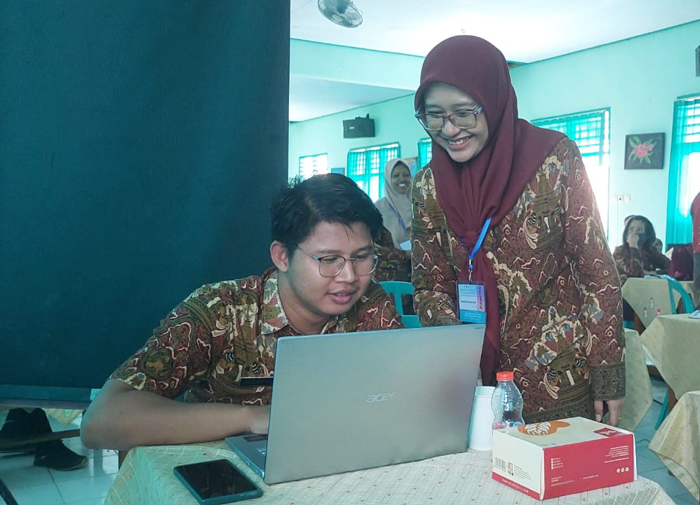
Implementation in School, Class, and Community
1. In Junior High School - Scratch

Slide 10
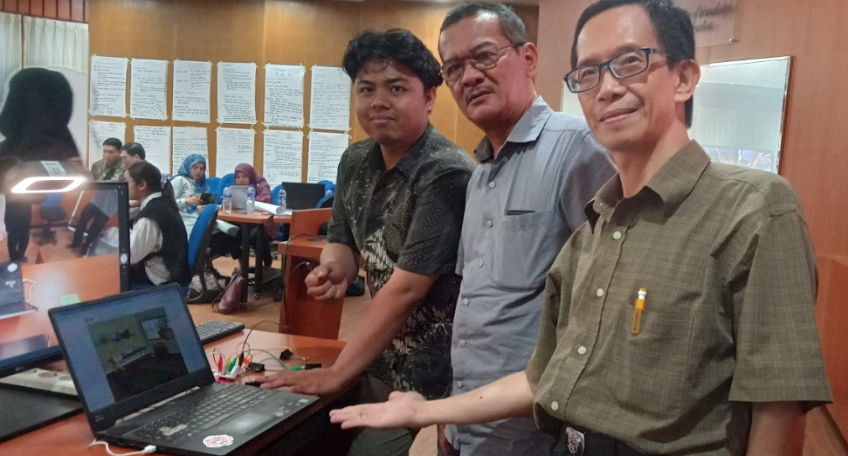
Implementation in School, Class, and Community
Bapak Trangnjono Soewarno– SMP Kristen Gloria 2 – Surabaya

Slide 11
Implementation in School, Class, and Community
2. Senior High School
Algorithms and Programming : C → Variable, algorithm, pseudocode, flowchart, loops, if
Data Analysis : Python → print, array, looping, import

Slide 12
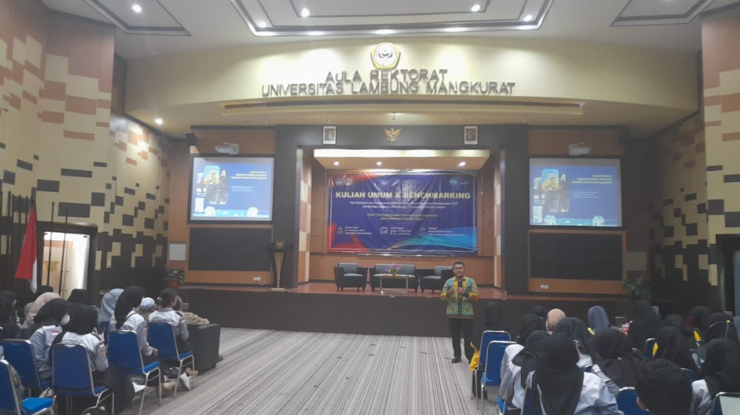
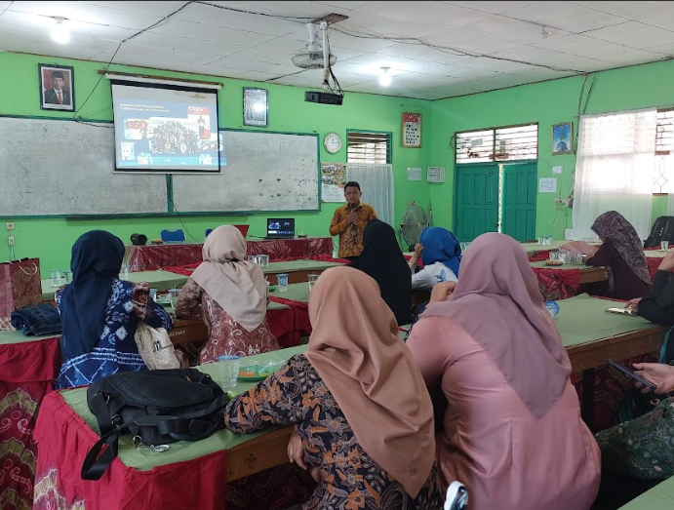
Implementation in School, Class, and Community
Bapak Nur Rahmat Wahyuaji – SMA Negeri1 Gambut – Kalimantan Selatan

Slide 13
Implementation in School, Class, and Community
3. Vocational High School → software engineering
10th grade = Scratch, C, Python
11th grade = web programing → html, CSS, JavaScript, SQL
Mobile Application → Android studio, Flask, Python
12th grade = UI/UX

Slide 14
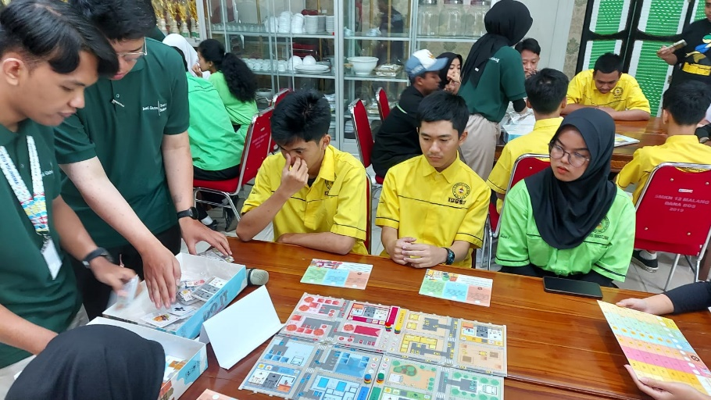
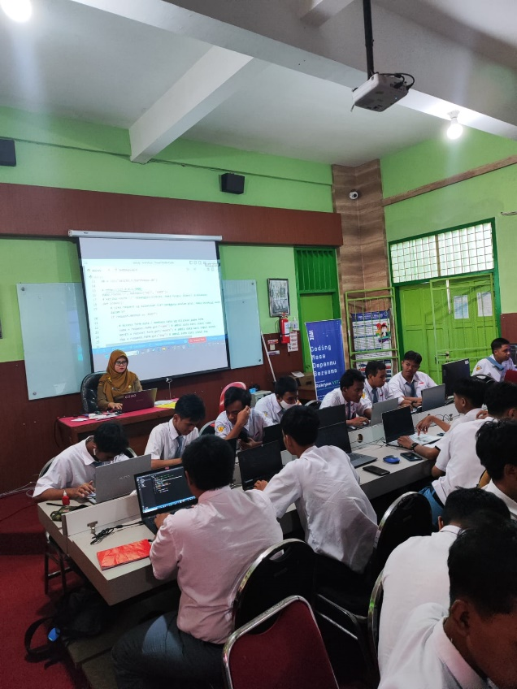
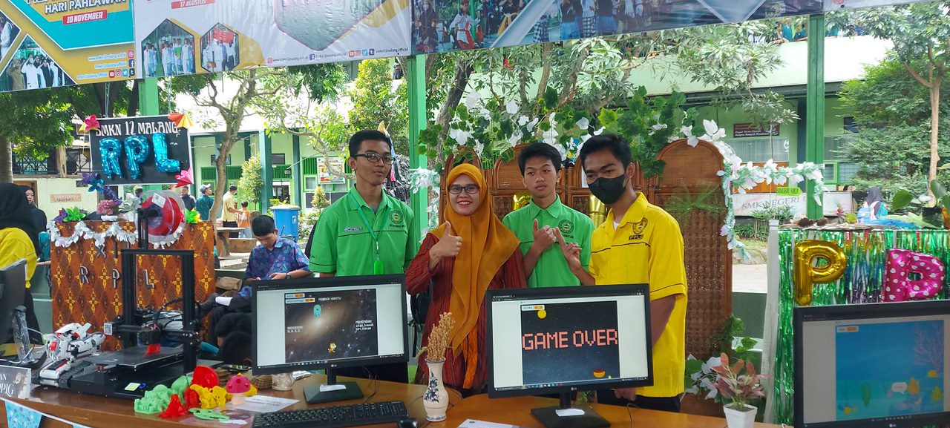
Implementation in School, Class, and Community
Ibu Listianty Dewi A – SMK Negeri 12 Malang

Slide 15
Implementation in School, Class, and Community
For another subject (English Teacher, Physics Teacher, Math Teacher, etc)
Adapt and adopt the curriculum of CS50
Pedagogy
Critical Thinking
Logical Thinking
Problem solving
Discipline

Slide 16
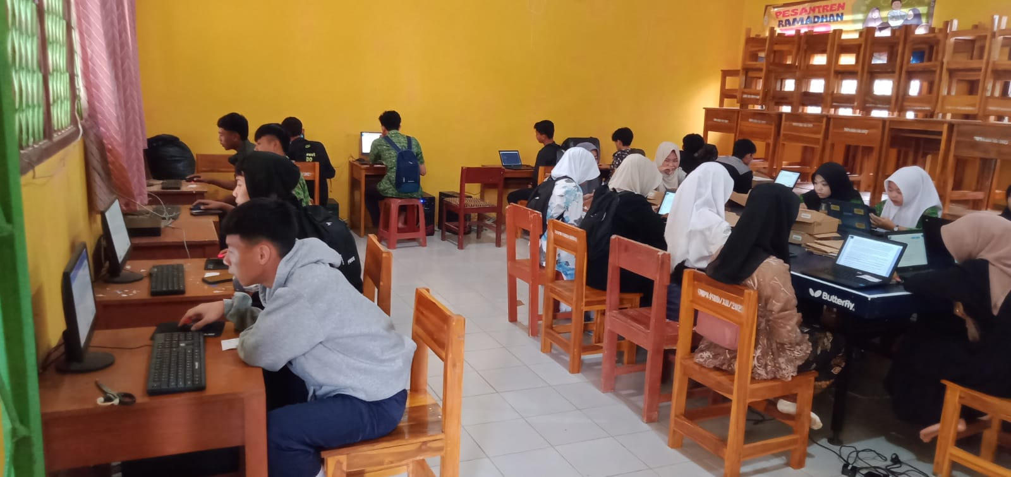
Implementation in School, Class, and Community
Bapak Sandi Maulana Abdillah – SMP Negeri 4 Surade Sukabumi
Use scratch to make English short story

Slide 17
Ice Breaking

Slide 18
Reflection
After join the CS50 I know about computational thinking and problem solving, programming language
Be an honest person at work (Academic honesty)
Be an discipline teacher
There will always be a light at the end of the tunnel

Slide 19
Motivation
Believe that you can achieve it and be disciplined with your time management.
Difficult? Yes, Give up? Don’t
This is not the end but beginning of your journey
Keep up the spirit of CS50
Spread all of what you get from CS50 to your student, fellow teachers and your community

Slide 20
WELCOME TO THE CS50X-INDONESIA COMMUNITY
THANK YOU

